Slide 1
Build a I2C based sensor Array
I2C Part 2 - Build a I2C Sensor
https://www.youtube.com/watch?v=yBgikWNoU9o
https://dronebotworkshop.com/i2c-part-2-build-i2c-sensor/
https://dronebotworkshop.com/hc-sr04-ultrasonic-distance-sensor-arduino/

Slide 2
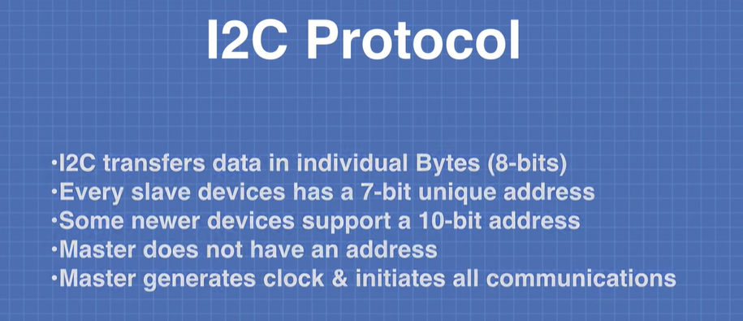
I2C Protocol

Slide 3
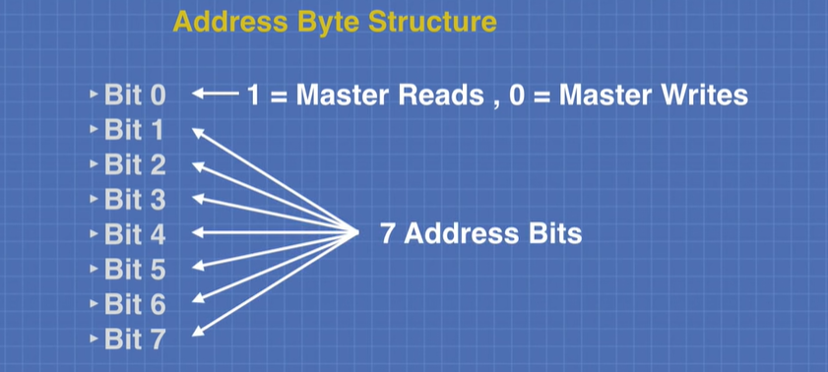
I2c protocol
Every I2C Slave has an address that is unique on the I2C bus.
Masters do not have addresses. The address is used by the Master to communicate with a Slave, one device at a time.
Most I2C devices use a 7-bit addressing scheme, some newer devices use a 10-bit address.
Bits 1-7 gives 128 device possibilities, however, few address bits are reserved, so max slave devices that can be connected is less than 128.

Slide 4
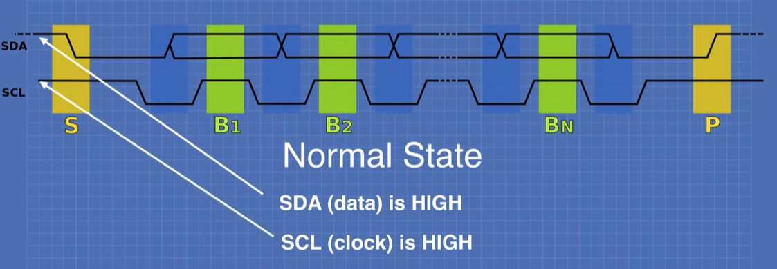
I2C Protocol
The two communications connections are as follows:
SDA – This is the serial data line. I2C is a unidirectional system, so data can only travel in one direction at any given moment.
SCL – The clock signal, which synchronizes the data.
I2C works on the principle of Masters and Slaves, the Master provides the clock signal and orchestrates all of the communications.
Only one device can be master at any given moment, there can be several Slaves.

Slide 5
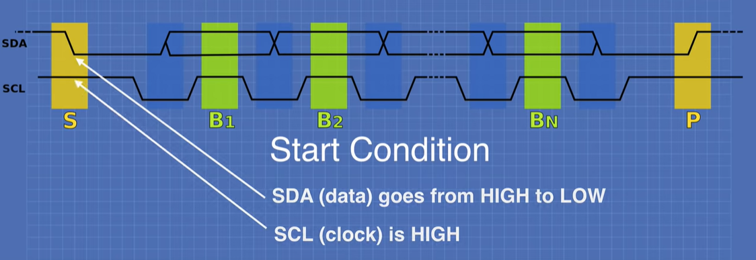
I2c Protocol

Slide 6
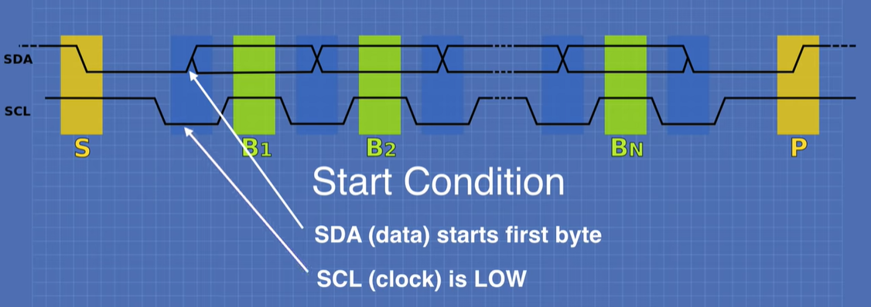
I2c Protocol

Slide 7
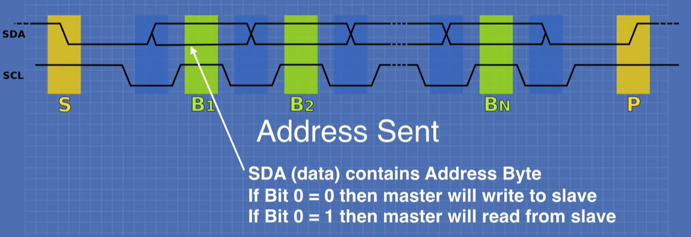
I2c Protocol
B2, B3,…..Bn are multiple bytes of data sent between Master and Slave (after Address Byte was sent).

Slide 8
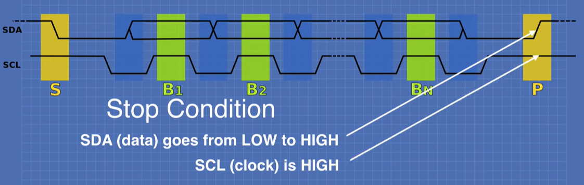
I2c Protocol

Slide 9


HARDWARE & SOFTWARE requirements

Slide 10
Hardware Required
Arduino (Uno / Mega) x 2 pcs (First as Master, Second as Slave)
Hookup cables
Usb cables x 2 for power and firmware download
Ultrasonic Sensors (HC SR04) x 4
SOFTWARE Required
Wire Library
NewPing Library (for Ultrasonic Sensors – HC SR04)

Slide 11
Ultrasonic sensor hc-sr04

Slide 12
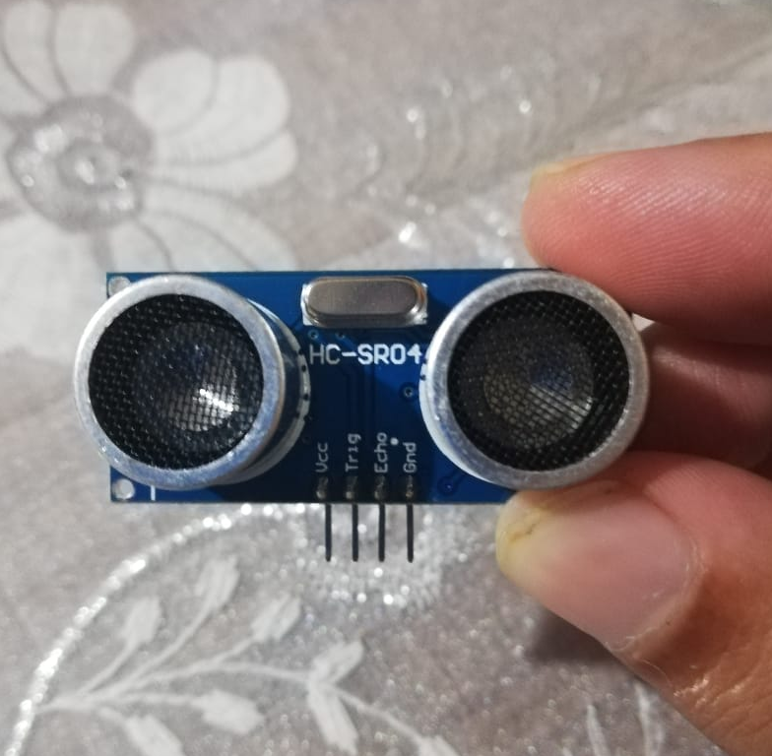
HC-SR04 Ultrasonic Sensor
As with most ultrasonic sensors, the HC-SR04 consists of a transmitter and receiver. The transmitter sends pulses of ultrasonic sound towards the target, and the receiver picks up the reflected signal.
As the pulses travel at the speed of sound it is just a matter of measuring the time delay between sending and receiving the pulse. This can be used to calculate the distance.
In our first demonstration we will simply test the sensor to see if it is working. The sketch is pretty simple and it uses the Serial Monitor to display the distance it detects, measured in centimeters. Let’s look it over in detail.
If you want to display your results in inches instead of centimeters there are two ways you can do this:
Use the Imperial value for the speed of sound instead of the Metric one. At sea level at 20 degrees Celsius (68 degrees Fahrenheit) sound travels at 343 metres per second, which is 1,125 feet per second or 13500 inches per second.
Keep the code as it is but convert to inches at the end. There are 2.54 centimetres in an inch. Personally this is how I would do this, as it would allow me to display the results in both Imperial and Metric values.

Slide 13
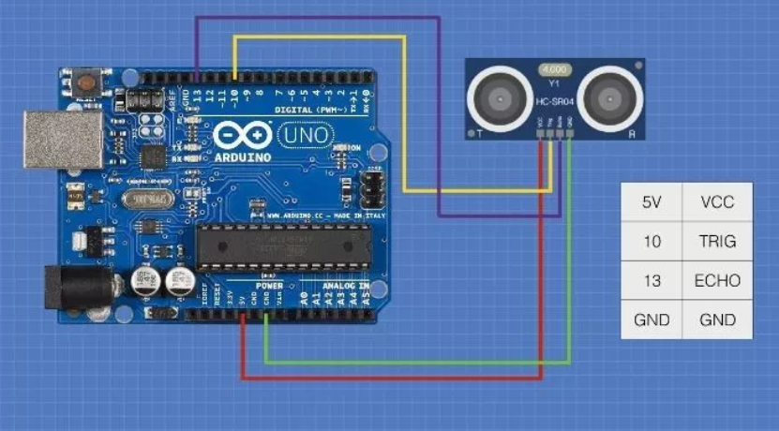
Circuit Hooking Up the HC-SR04
Connecting the HC-SR04 to the Arduino is pretty easy. You’ll need a couple of digital I/O ports and a connection to the Arduino’s 5-Volt and Ground pins.
Actually if you’re short of pins you can even connect both the Trigger and Echo pins of the HC-SR04 to just one digital I/O pin on the Arduino and use code to switch the pin between output (to send the 10 uS pulse) and input (to receive the Echo pulse).
Some ultrasonic sensors actually have only one pin that does both Trigger and Echo.
Most of the examples I’ll be showing you here use the more conventional two-pin method. Any Arduino and any digital I/O pins that are free can be used so if you wish to hook it up to a different set of I/O pins then simply change the sketches to reflect those changes. For our demo I’ll use an Arduino Uno and pin 10 for the Trigger and pin 13 for the Echo.
The application notes for the HC-SR04 stress that you need to have the Ground pin connected before you hook up VCC (5-Volts), so if you’re experimenting “live” on a solderless breadboard you might want to keep that in mind.

Slide 14
Actual PICS

Slide 15
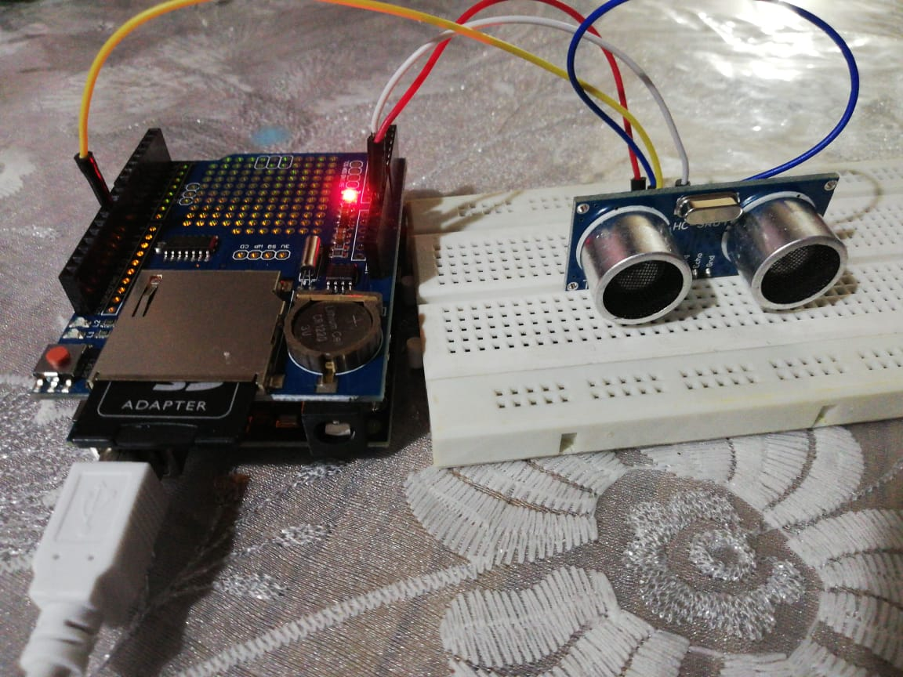
Actual PICS

Slide 16
Code Hooking Up the HC-SR04
// Hook up HC-SR04 with Trig to Arduino Pin 10, Echo to Arduino pin 13
#define trigPin 10
#define echoPin 13
float duration, distance;
void setup() {
Serial.begin (115200);
pinMode(trigPin, OUTPUT);
pinMode(echoPin, INPUT);
}
void loop() {
// Write a pulse to the HC-SR04 Trigger Pin
digitalWrite(trigPin, LOW);
delayMicroseconds(2);
digitalWrite(trigPin, HIGH);
delayMicroseconds(10);
digitalWrite(trigPin, LOW);
// Measure the response from the HC-SR04 Echo Pin
duration = pulseIn(echoPin, HIGH);
// Determine distance from duration
// Use 343 metres per second as speed of sound
distance = (duration / 2) * 0.0343;
// Send results to Serial Monitor
Serial.print("Distance = ");
if (distance >= 400 || distance <= 2) {
Serial.println("Out of range");
}
else {
Serial.print(distance);
Serial.println(" cm");
delay(500);
}
delay(500);
}

Slide 17
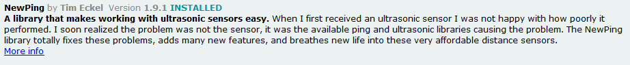
Code Hooking Up the HC-SR04 USING “NEWPING” LIBRARY
In our first sketch we didn’t use any code libraries, we simply used the Arduino’s delayMicrosecond command to create our 10 uS pulse for triggering and the pulseIn command to measure the received signal pulse width.
However there are other ways of doing this using special code libraries. There are quite a few of them available, the most versatile is one called “NewPing”.
The NewPing library was written by Tim Eckel and it replaces the older Ping library which was written by Caleb Zulawski and designed primarily for the Parallax Ping ultrasonic sensor (although it will work with the HC-SR04 if you use it in 3-pin mode).
The NewPing library is quite advanced and it improves upon the accuracy of our original sketch considerably. It also supports up to 15 ultrasonic sensors at once and it can directly output in centimetres, inches or time duration.
The previous sketch is simple and works well but it only has a resolution down to one centimeter.
If you want to bring back the decimal point values you can use NewPing in duration mode instead of in distance mode. We can then use the duration to calculate the distance as we did in the first sketch we looked at.
Here is our sketch NewPing rewritten to use duration instead of distance.

Slide 18
Code Hooking Up the HC-SR04 NewPing Library v01 - Distance
// This uses Serial Monitor to display Range Finder distance readings
// Include NewPing Library
#include "NewPing.h"
// Hook up HC-SR04 with Trig to Arduino Pin 10, Echo to Arduino pin 13
// Maximum Distance is 400 cm
#define TRIGGER_PIN 10
#define ECHO_PIN 13
#define MAX_DISTANCE 400
NewPing sonar(TRIGGER_PIN, ECHO_PIN, MAX_DISTANCE);
float distance;
void setup() {
Serial.begin (115200);
Serial.println("Launching Firmware - New Ping v0.1 - Distance");
}
void loop() {
distance = sonar.ping_cm();
// Send results to Serial Monitor
Serial.print("Distance = ");
if (distance >= 400 || distance <= 2) {
Serial.println("Out of range");
}
else {
Serial.print(distance);
Serial.println(" cm");
delay(500);
}
delay(500);
}

Slide 19
Code Hooking Up the HC-SR04 NewPing Library v02 - Duration
// Include NewPing Library
#include "NewPing.h"
// Hook up HC-SR04 with Trig to Arduino Pin 10, Echo to Arduino pin 13
// Maximum Distance is 400 cm
#define TRIGGER_PIN 10
#define ECHO_PIN 13
#define MAX_DISTANCE 400
NewPing sonar(TRIGGER_PIN, ECHO_PIN, MAX_DISTANCE);
float duration, distance;
void setup() {
Serial.begin (115200);
Serial.println("Launching Firmware - New Ping v0.2 - Duration");
}
void loop() {
duration = sonar.ping();
// Determine distance from duration
// Use 343 metres per second as speed of sound
distance = (duration / 2) * 0.0343;
// Send results to Serial Monitor
Serial.print("Distance = ");
if (distance >= 400 || distance <= 2) {
Serial.println("Out of range");
}
else {
Serial.print(distance);
Serial.println(" cm");
delay(500);
}
delay(500);
}

Slide 20
Code Hooking Up the HC-SR04 NewPing Library v03 - Iterations
// Include NewPing Library
#include "NewPing.h"
// Hook up HC-SR04 with Trig to Arduino Pin 10, Echo to Arduino pin 13
// Maximum Distance is 400 cm
#define TRIGGER_PIN 10
#define ECHO_PIN 13
#define MAX_DISTANCE 400
NewPing sonar(TRIGGER_PIN, ECHO_PIN, MAX_DISTANCE);
float duration, distance;
int iterations = 5;
void setup() {
Serial.begin (115200);
Serial.println("Launching Firmware - New Ping v0.3 - Iterations");
}
void loop() {
duration = sonar.ping_median(iterations);
// Determine distance from duration
// Use 343 metres per second as speed of sound
distance = (duration / 2) * 0.0343;
// Send results to Serial Monitor
Serial.print("Distance = ");
if (distance >= 400 || distance <= 2) {
Serial.println("Out of range");
}
else {
Serial.print(distance);
Serial.println(" cm");
delay(500);
}
delay(500);
}

Slide 21
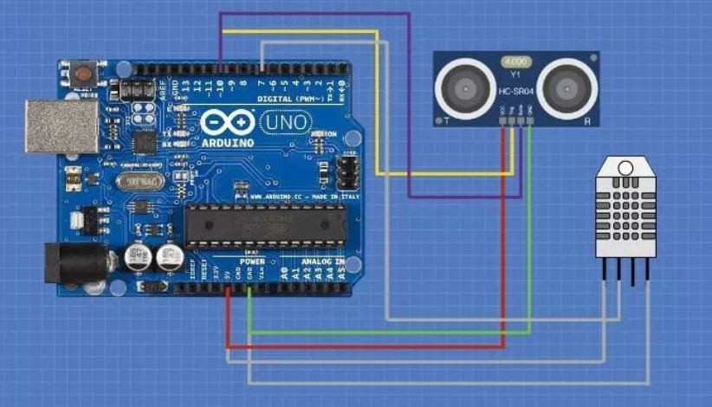
Hooking up hc-sr04 Using 3-Wire Mode
It is possible to use the HC-SR04 in “3-Wire Mode”. In this mode you will only require one connection to a single Arduino digital I/O pin. There are other ultrasonic sensors that only operate in 3-Wire Mode.
In 3-Wire mode the single I/O pin is used as both an input and as an output. This is possible because there is never a time when both the input and output are being used. By eliminating one I/O pin requirement we can save a connection to our Arduino and use it for something else. It also is useful when using a chip like the ATtiny85 which has a limited number of I/O pins.
As you can see all I did was to connect both the trigger and echo to Arduino pin 10.
And here is the sketch I wrote to use it. Note that the only difference between this sketch and the previous one is that I’ve specified pin 10 for both the Trigger and Echo pin values. The rest of the sketch is identical.

Slide 22
Code Hooking Up the HC-SR04 NewPing Library v04 – THREE WIRE
// Include NewPing Library
#include "NewPing.h"
// Hook up HC-SR04 with Trig to Arduino Pin 10, Echo to Arduino pin 13
// Maximum Distance is 400 cm
#define TRIGGER_PIN 10
#define ECHO_PIN 10
#define MAX_DISTANCE 400
NewPing sonar(TRIGGER_PIN, ECHO_PIN, MAX_DISTANCE);
float duration, distance;
int iterations = 5;
void setup() {
Serial.begin (115200);
Serial.println("Launching Firmware - New Ping v0.4 – Three Wire Connection");
}
void loop() {
duration = sonar.ping_median(iterations);
// Determine distance from duration
// Use 343 metres per second as speed of sound
distance = (duration / 2) * 0.0343;
// Send results to Serial Monitor
Serial.print("Distance = ");
if (distance >= 400 || distance <= 2) {
Serial.println("Out of range");
}
else {
Serial.print(distance);
Serial.println(" cm");
delay(500);
}
delay(500);
}

Slide 23

Using Multiple HC-SR04 Sensors

Slide 24
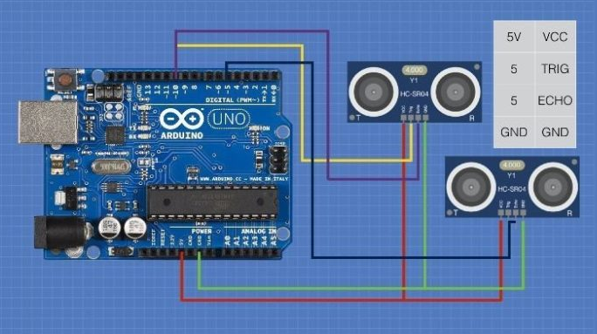
Using Multiple HC-SR04 Sensors
In many applications you’ll want to use more than one HC-SR04 ultrasonic sensor in your design. This can happen when you want to monitor the distance to external objects from different sides of your robot or project.
Autonomous car with obstacle avoidance systems ( 4 sensors on either sides ).
When using multiple sensors one obvious consideration is that you need to keep the signal emitted by one sensor from being picked up and measured by another sensor. The easiest way to accomplish this is to simply pulse the trigger on one sensor and wait until you receive the echo back before proceeding to the next sensor. It might be wise to leave a small delay between readings just in case the previous sensors sound waves are still bouncing around the room!
Here is how I used two HC-SR04 ultrasonic sensor with the Arduino. Note that I wired these in 3-wire mode, if you wish you can also connect them in the conventional 4-wire fashion. If you do then just modify the sketch to specify different trigger and echo pins.

Slide 25
Code – Using Multiple HC-SR04 Sensors
// Include NewPing Library
#include "NewPing.h"
// Define Constants
#define TRIGGER_PIN_1 10
#define ECHO_PIN_1 10
#define TRIGGER_PIN_2 5
#define ECHO_PIN_2 5
#define MAX_DISTANCE 400
NewPing sonar1(TRIGGER_PIN_1, ECHO_PIN_1, MAX_DISTANCE);
NewPing sonar2(TRIGGER_PIN_2, ECHO_PIN_2, MAX_DISTANCE);
// Define Variables
float duration1; // Stores First HC-SR04 pulse duration value
float duration2; // Stores Second HC-SR04 pulse duration value
float distance1; // Stores calculated distance in cm for First Sensor
float distance2; // Stores calculated distance in cm for Second Sensor
int iterations = 5;
void setup() {
Serial.begin (115200);
Serial.println("Launching Firmware - Connect Two Ultrasonic Sensors (in 3-wire mode) on Pins 5 & 10 ");
}

Slide 26
Code – Using Multiple HC-SR04 Sensors
void loop()
{
delay(1000);
// Measure duration for first sensor
duration1 = sonar1.ping_median(iterations);
// Add a delay between sensor readings
delay(1000);
// Measure duration for first sensor
duration2 = sonar2.ping_median(iterations);
// Calculate the distances for both sensors
// Use 343 metres per second as speed of sound
distance1 = (duration1 / 2) * 0.0343;
distance2 = (duration2 / 2) * 0.0343;
// Send results to Serial Monitor
Serial.print("Distance 1: ");
if (distance1 >= 400 || distance1 <= 2) {
Serial.print("Out of range ");
}
else {
Serial.print(distance1);
Serial.print(" cm ");
}
Serial.print("Distance 2: ");
if (distance2 >= 400 || distance2 <= 2) {
Serial.print("Out of range ");
}
else {
Serial.print(distance2);
Serial.print(" cm");
}
Serial.println(" ");
}

Slide 27
Be Kind to Animals!
One thing that bears consideration when designing a device around any ultrasonic emitter, like the HC-SR04, is that many animals can hear ultrasonic sound. According to WikiPedia this includes dogs, cats, gerbils and rabbits.
If you have furry 4-legged friends roaming your house you might want to refrain from subjecting them to the sound emitted by the sensor as it could be very annoying to them. Imagine hearing a high pitched series of “beeps” every second nonstop and you can empathize with what your pet might be going through.
There are other methods of measuring distance like IR light and LIDAR that don’t involve ultrasonic sound, so you might want to look into that if animals are a consideration in your home.

Slide 28

PINOUT

Slide 29
PINOUT

Slide 30
Hobby project(s)

Slide 31
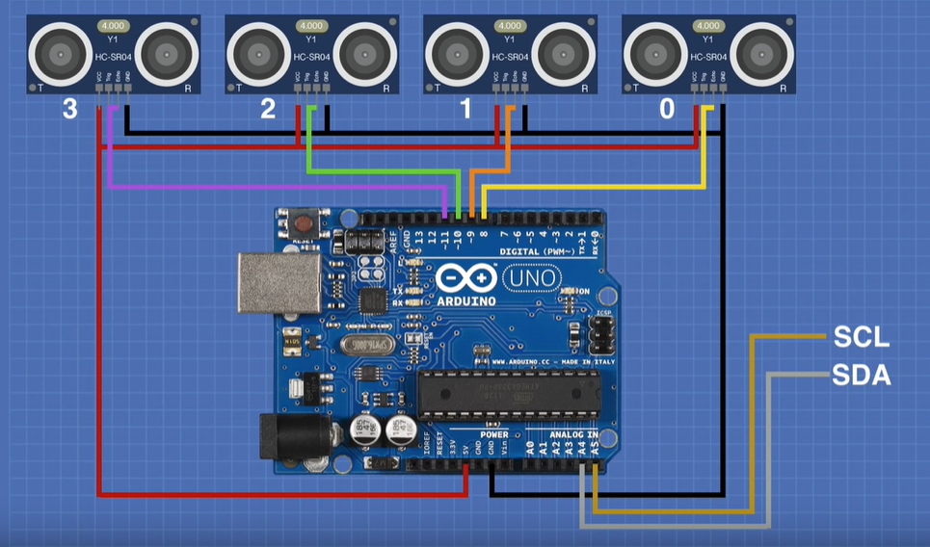
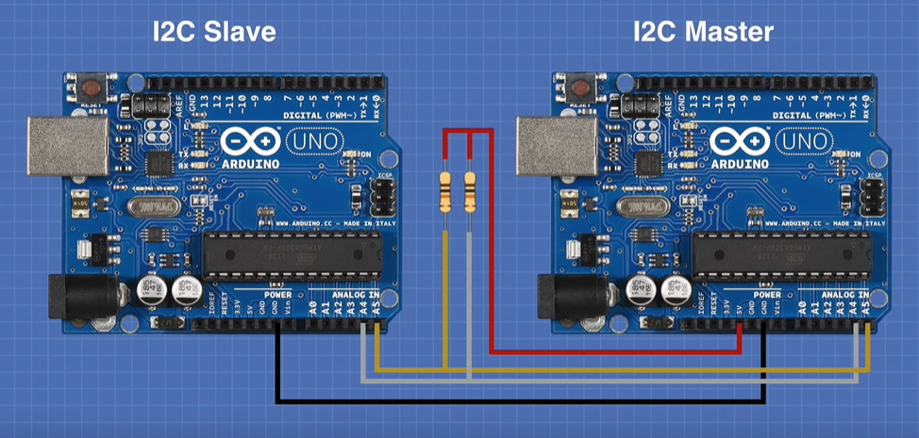
Circuit
← I2C Slave Circuit
I2C Master Slave Circuit →

Slide 32
Hookup
The HC-SR04 has four pins. Two are used for power and ground, the other two for the transmit (Trigger) and receive (Echo).
To save on wiring you can run the sensor in “1-pin mode”, tying the Trigger and Echo pins together. Your code just needs to flip between sending and receiving, and you save some wiring.
Otherwise, the wiring is fairly simple. In addition to the sensor wiring, we will use two of the Arduino’s analog pins, A4 and A5, as I2C connections. A4 is the SDA connection while A5 is the SCL.

Slide 33
Actual PICS

Slide 34
Actual PICS

Slide 35
Ultrasonic Sensor Test Sketch

Slide 36
Code – Ultrasonic Sensor Test Sketch
// Include NewPing Library for HC-SR04 sensor
#include <NewPing.h>
// Hook up 4 HC-SR04 sensors in 1-pin mode
// Sensor 0
#define TRIGGER_PIN_0 8
#define ECHO_PIN_0 8
// Sensor 1
#define TRIGGER_PIN_1 9
#define ECHO_PIN_1 9
// Sensor 2
#define TRIGGER_PIN_2 10
#define ECHO_PIN_2 10
// Sensor 3
#define TRIGGER_PIN_3 11
#define ECHO_PIN_3 11
// Maximum Distance is 400 cm
#define MAX_DISTANCE 400
// Create objects for ultrasonic sensors
NewPing sensor0(TRIGGER_PIN_0, ECHO_PIN_0, MAX_DISTANCE);
NewPing sensor1(TRIGGER_PIN_1, ECHO_PIN_1, MAX_DISTANCE);
NewPing sensor2(TRIGGER_PIN_2, ECHO_PIN_2, MAX_DISTANCE);
NewPing sensor3(TRIGGER_PIN_3, ECHO_PIN_3, MAX_DISTANCE);
// Variables to represent distances
float distance0, distance1, distance2, distance3;

Slide 37
Code – Ultrasonic Sensor Test Sketch
void setup() {
Serial.begin (115200);
Serial.println("Launching Firmware - Multiple Ultrasonic Sensor Test Sketch ");
Serial.println("Connect Multiple Ultrasonic sensors in 3-wire mode on Pins 8, 9, 10, 11 ");
}
void loop() {
// Read sensors in CM
// Sensor 0
distance0 = sensor0.ping_cm();
delay(20);
// Sensor 1
distance1 = sensor1.ping_cm();
delay(20);
// Sensor 2
distance2 = sensor2.ping_cm();
delay(20);
// Sensor 3
distance3 = sensor3.ping_cm();
delay(20);
// Send results to Serial Monitor
// Sensor 0
Serial.print("Distance 0 = ");
if (distance0 >= 400 || distance0 <= 2) {
Serial.println("Out of range");
}
else {
Serial.print(distance0);
Serial.println(" cm");
delay(500);
}
// Sensor 1
Serial.print("Distance 1 = ");
if (distance1 >= 400 || distance1 <= 2) {
Serial.println("Out of range");
}
else {
Serial.print(distance1);
Serial.println(" cm");
delay(500);
}
// Sensor 2
Serial.print("Distance 2 = ");
if (distance2 >= 400 || distance2 <= 2) {
Serial.println("Out of range");
}
else {
Serial.print(distance2);
Serial.println(" cm");
delay(500);
}
// Sensor 3
Serial.print("Distance 3 = ");
if (distance3 >= 400 || distance3 <= 2) {
Serial.println("Out of range");
}
else {
Serial.print(distance3);
Serial.println(" cm");
delay(500);
}
delay(500);
}

Slide 38
I2C Based Ultrasonic Sensor

Slide 39
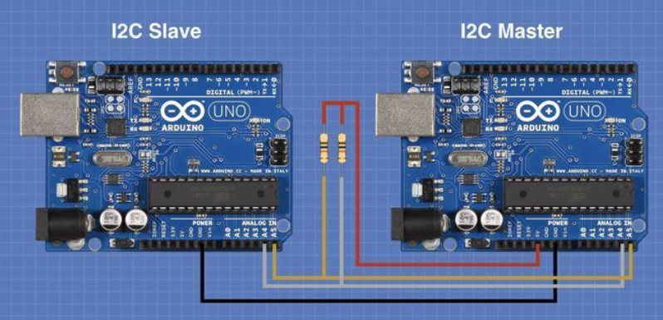
Remote I2C Sensor Array
Now that we have established that our sensors are working correctly it’s time to convert them into an I2C device.
In order to do this, we will need a second Arduino to serve as the Master. Our existing Arduino is already hooked up correctly to act as the Slave, all that will be required is to change the code so that the results are sent over the I2C bus when a request is received from the Master.
Hooking up the Master
The following diagram only shows the hookup between the Master and Slave Arduino’s. Remember to keep all of the existing wiring to the four HC-SR04 ultrasonic sensors intact!
As you can see the hookup is very simple. I am showing two 10k resistors used as pull-ups for the SDA and SCL lines, but you may not even need to use them.
On both Arduino’s the A4 line is also the SDA line, and A5 is SCL. Just connect both of those together, you’ll also need to connect the ground from each of the Arduino’s together.
If you do use the two pull-up resistors then use the 5-volt supply from the Master Arduino to act as the reference voltage. Do not tie the 5-volt lines from each Arduino together!
Once you have it all hooked up you’ll need to load two sketches, one on the Slave and one on the Master.

Slide 40
Code – i2c based sensor array
Arduino_Slave

Slide 41
Code Explanation - SLAVE
You‘ll notice many similarities to the previous sketch, it uses the NewPing library and defines the pins and sensor objects in the same way as before. It also uses the Arduino Wire library for I2C communications, this library is part of your Arduino IDE so you won’t need to install it.
We need to pick an address for our device, I chose 9 but you can pick anything really. If you plan to implement a permanent version of this in one of your designs you should choose an address that won’t conflict with any other I2C devices that you may be using.
The maximum distance has been reduced here, this is because we really are not planning to measure anything over 254 cem. This is because we want to fit our data into one byte.
Instead of using four separate variables to hold the four distance measurements we will put them into a 4-element array.
We are going to send the four distance variables one after another, preceded by a “marker byte”, so we also need to define a counter to keep track of where we are in the response.
In the Setup, we set the device up as a Slave by passing the address to the Wire library.
We also need to specify a function that we will call every time we get a request from the Master. We will call the function requestEvent.
Before we examine the requestEvent function it would be a good idea to look at another function, readDistance, as this is used in the requestEvent function.
The readDistance function simply reads all four sensors and assigns their value to the elements in the array. As with our stand-alone test, there is a small delay between readings to prevent interference between sensors.
In the Loop, we execute the readDistance function every half-second. This means that when the Master asks for a value it will already be there waiting for it.
Now back up to the requestEvent function. This is the function that is called when the Master requests data.
Our response will be sent to the Master over the I2C bus as a string of individual bytes. To allow the Master to distinguish which byte belongs to each sensor we will start the sequence with “start byte” which always has a value of 255. This is why we need to limit our distance reading to 254 cm.
We use the counter we established earlier to cycle through the start byte and the four data values. For each of them, we use the Wire.write method to send the data back to the Master over the I2C bus.

Slide 42
Code – i2c based sensor array
Arduino_Master

Slide 43
Code Explanation - master
Once again we will use the Arduino Wire Library to handle all of the I2C functions. We will define an address for the Slave that we want to communicate with, in this case, I chose 9 to match the Slave sketch.
As with the previous sketch, we will define a counter to count the incoming bytes and an array to hold the four distance values we receive.
In the Setup, we initialize the I2C bus. Note that we do not specify an address this time, this lets the Wire library know that we wish to operate as a Master.
We also set up the serial monitor so we can look at the incoming data.
Next, we create a function called readI2C. It has one parameter, the address of the device we want to read, and it outputs a byte of data.
The function makes use of the Arduino millis function, this is a function that outputs the number of milliseconds that have elapsed since the Arduino was powered up or reset. It will be used as a timer, to allow the data to settle.
A Wire.request is used to request data from the slave. Remember, in this application, this will bring back one byte of data. We return that byte as the function’s output.
In the Loop, we call the readI2C function and read the data. We wait until it equals 255, as this is the start of our data sequence.
The next four reads are going to be the data from the four ultrasonic sensors. We put each value into our array.
Finally, we print the array values to the serial monitor. They are spaced with a tab character toi make it easier to read.
Load the sketch and keep the computer plugged into the Master Arduino so you can observe the readings on the serial monitor.

Slide 44
TROUBLESHOOT guide

Slide 45
TROUBLESHOOT guide
1. Even after connecting I2C SDA and SCL lines on Arduino, the communication doesn’t seem to happen.
What can I do to improve this??
Try adding a Pull up resistor (External Pull up). Although this is not always needed.
In case of Arduino Uno , we may need to add external pull up resistors on A4 & A5 pins.
However, in case of Arduino Mega (pin 20 & 21 have internal pull-up resistors already present.
Check if the Slave Address is properly calculated and passed.

Slide 46
CONCLUSION

Slide 47
Conclusion
As you can see it is not that difficult to build your own I2C sensors, especially now that you understand the protocol used on the I2C bus.
You can make them a lot smaller and more efficient by using (in place of the Arduino Uno):
Arduino Pro Mini or
ATmega328 chip
And you can certainly add more functions to them than this simple experiment.

